Slide 1
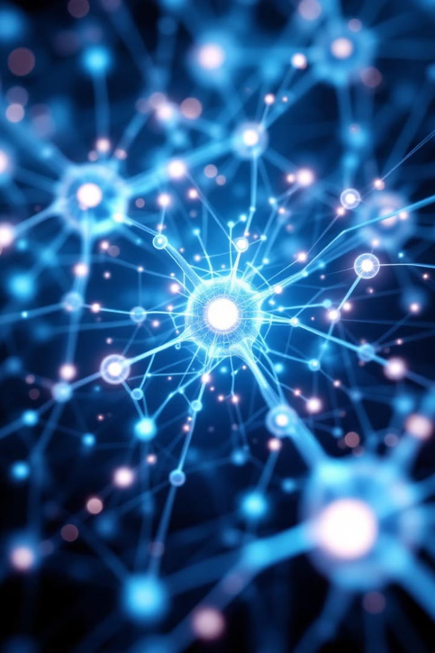
Deep Learning for Image Classification
Instructor: Stephin Rachel Thomas
February 12, 2026

Slide 2
Today’s Topics
Fundamentals of Image classification with CNN
Dataset Preparation
Discussion
Data augmentation Strategy
Designing CNN architecture
Activation Functions
Loss Functions
Back propagation
Optimizers
Training CNN
Common issues in Computer vision
Troubleshooting in CNN Training
Midterm test details

Slide 3

INTRODUCTION
Deep Learning, a subset of machine learning, involves neural networks with many layers.
In computer vision, deep learning powers tasks such as image classification, object detection, and semantic segmentation.
These tasks are accomplished through models that can identify patterns and features in images, mimicking human vision.

Slide 4
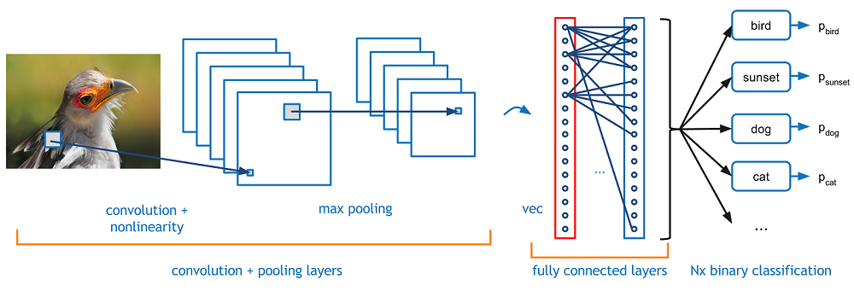
Fundamentals of Image Classification with CNNs
Image classification with CNNs involves categorizing and labeling images into predefined classes.
CNNs process images through layers that detect features, reduce dimensions, and classify images based on learned patterns.
Key components include convolutional layers for feature extraction, pooling layers for dimensionality reduction, and fully connected layers for classification.

Slide 5
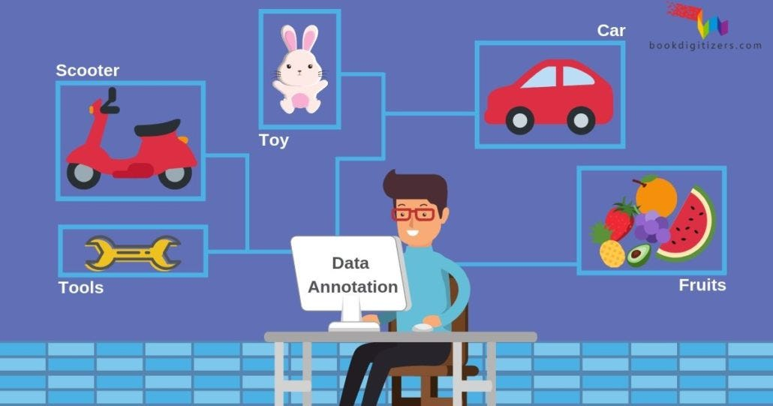
Dataset Preparation: Collection and Annotation
Dataset preparation is a vital step in image classification.
It involves collecting a diverse set of images representing different classes.
Annotation, the process of labeling images with class names, is essential for supervised learning.
Quality and diversity of the dataset directly impact the model's ability to learn and generalize to new, unseen images.

Slide 6
Data Preprocessing Techniques for Image Data
Preprocessing is crucial for preparing images for CNNs.
It includes resizing images to a uniform size, normalizing pixel values (typically to a 0-1 range), and converting images to grayscale or other color spaces if needed.
These steps ensure consistent input for the CNN, aiding in effective learning and reducing computational load.

Slide 7
Discussion – Why do we split our data into train, validation, and testing sets?

Slide 8
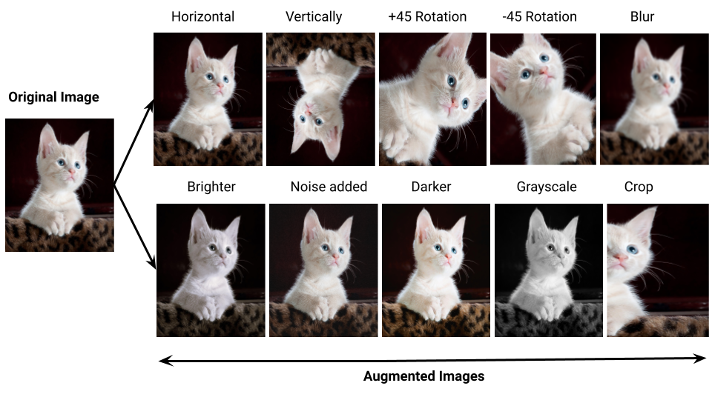
Data Augmentation Strategies in Image Classification
Data augmentation artificially expands the training dataset by applying random transformations like rotation, scaling, flipping, and cropping to the images.
This process helps in reducing overfitting, as it exposes the model to a wider variety of features and scenarios, making it more robust and improving generalization.

Slide 9

Designing a CNN Architecture: Key Considerations
Designing a CNN involves decisions about the number of layers, types of layers (convolutional, pooling, fully connected), and their parameters (like filter size, stride, and activation functions).
The architecture should match the complexity of the task; deeper networks for more complex tasks, and consideration of computational efficiency and overfitting risks.

Slide 10
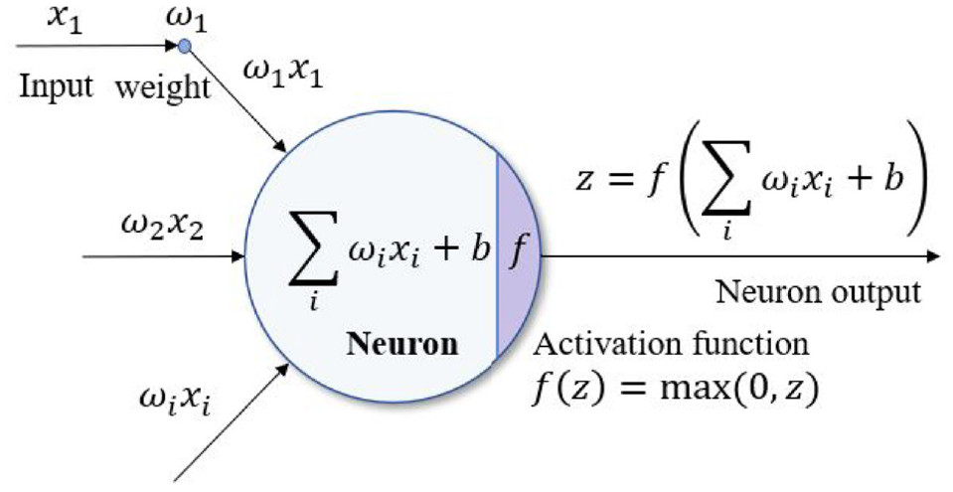
Activation Functions
Activation function determines if a neuron fires
Introduces nonlinearity to the network
Applied after convolution layer, after each fully conncted later and output layer allowing the network to learn and represent complex patterns in the data

Slide 11
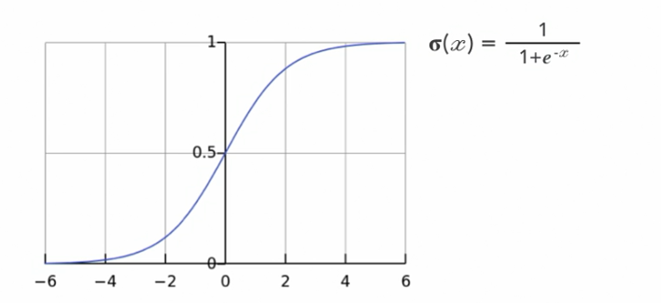
Different types of Activation Functions
Sigmoid
Output of activation function between 0 and 1
Suitable for binary classification tasks
Vanishing gradient problem – near boundaries, the network doesn’t learn quickly
Used for output layer activation in binary classification

Slide 12
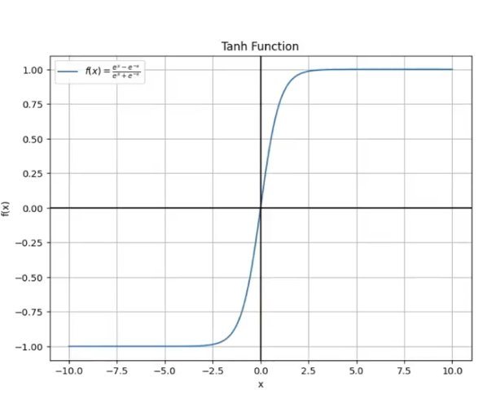
Tanh
Maps inputs to a range between -1 and 1
Provides a more balanced output with zero-centered data
Smooth and differentiable activation function
Shares vanishing gradient problem with sigmoid
Used for handling negative input values

Slide 13
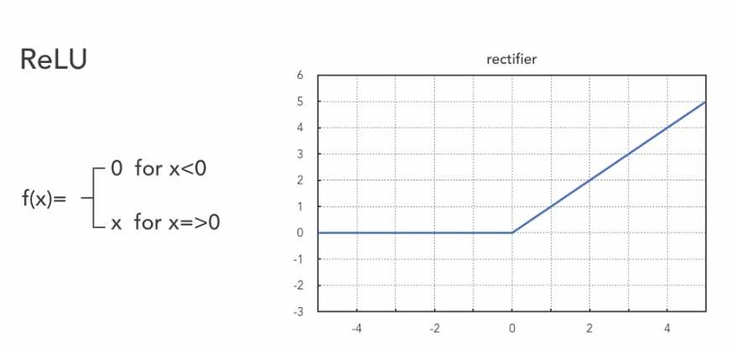
ReLU – Rectified Linear Unit
Only input values > 0 are kept
Range [0, ∞]
f(x)= max(0, x)
While keeping positive values unchanged, it promotes sparse representations, reducing overfitting
Mitigates vanishing gradient problem, enabling faster learning
Most commonly used for efficiency and in the hiddenlayers of feed forward neural networks

Slide 14
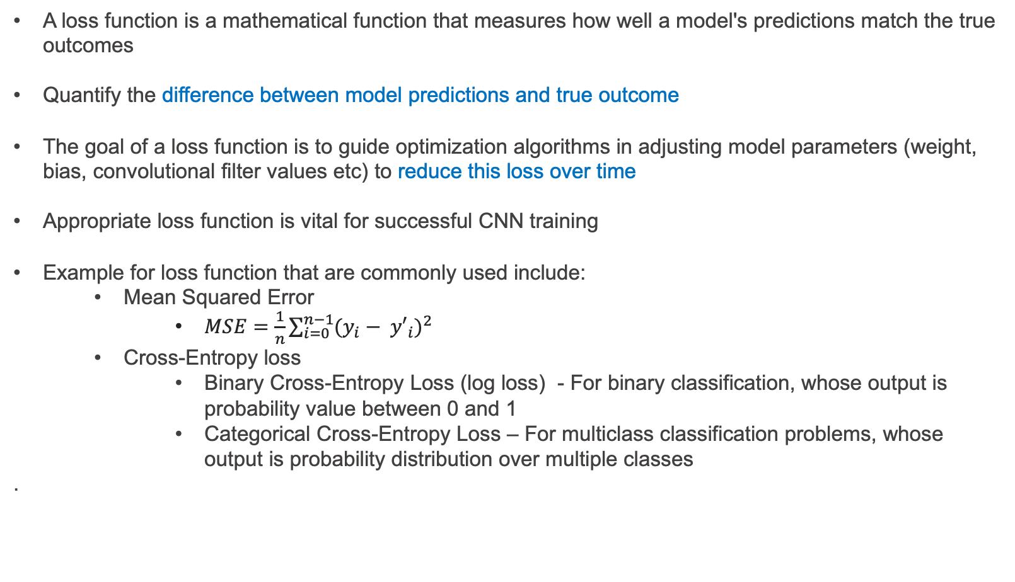
Loss Functions
A loss function is a mathematical function that measures how well a model's predictions match the true outcomes
Quantify the difference between model predictions and true outcome
The goal of a loss function is to guide optimization algorithms in adjusting model parameters (weight, bias, convolutional filter values etc) to reduce this loss over time
Appropriate loss function is vital for successful CNN training
Example for loss function that are commonly used include:
Mean Squared Error
$MSE=\frac{1}{n}\sum_{i=0}^{n−1}{{(y_{i}− {y′}_{i})}^{2}}$
Cross-Entropy loss
Binary Cross-Entropy Loss (log loss) - For binary classification, whose output is probability value between 0 and 1
Categorical Cross-Entropy Loss – For multiclass classification problems, whose output is probability distribution over multiple classes
.
Notes:
(log loss)

Slide 15
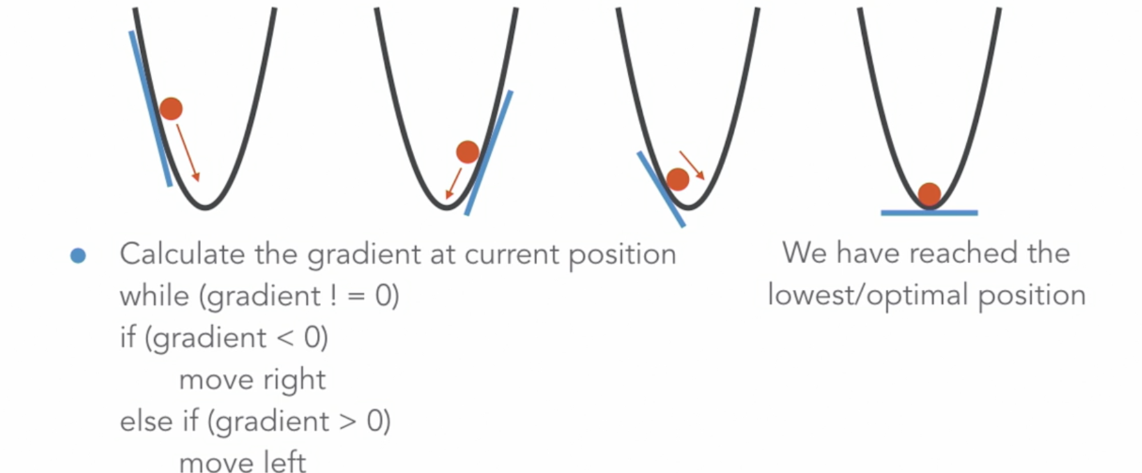
Gradient Descent
Most models use gradient descent or its variants to minimize the loss
It is an optimizing algorithm which is used to iterate through different combinations of weights to find the best
combination of weights that minimizes the error
The algorithm calculates the gradient of the loss function with respect to the model parameters and updates the
parameters in the opposite direction of the gradient.

Slide 16
Back Propagation
A critical algorithm in training CNN used to compute gradients of the loss function with respect to the weights in a neural network.
It happens only during training
Basic Steps are;
Feed a sample to the network
Calculate the mean squared error
Calculate the error term of each output neuron
Iteratively calculate the error terms In the hidden layers
Apply the delta rule
Adjust the weights
Notes:
(log loss)

Slide 17
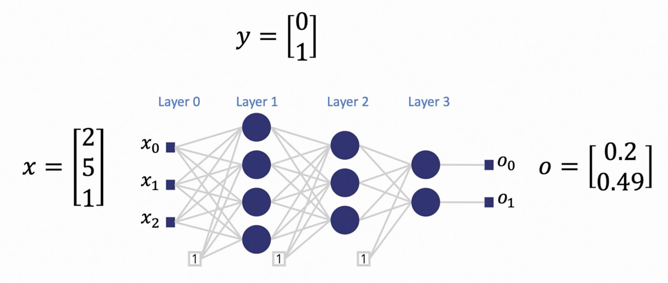
Step 1: Feed a sample to the Network
Notes:
(log loss)

Slide 18
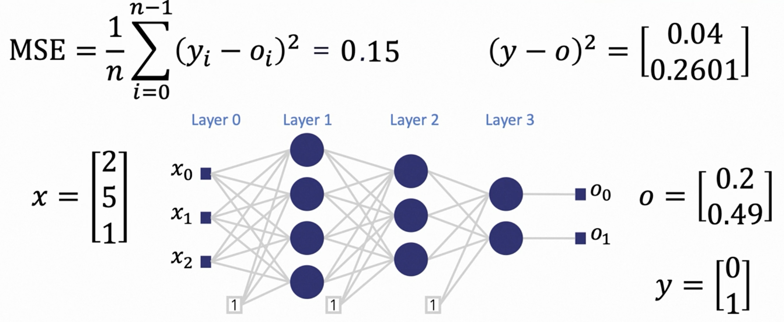
Step 2: Calculate Mean Squared Error
Notes:
(log loss)

Slide 19
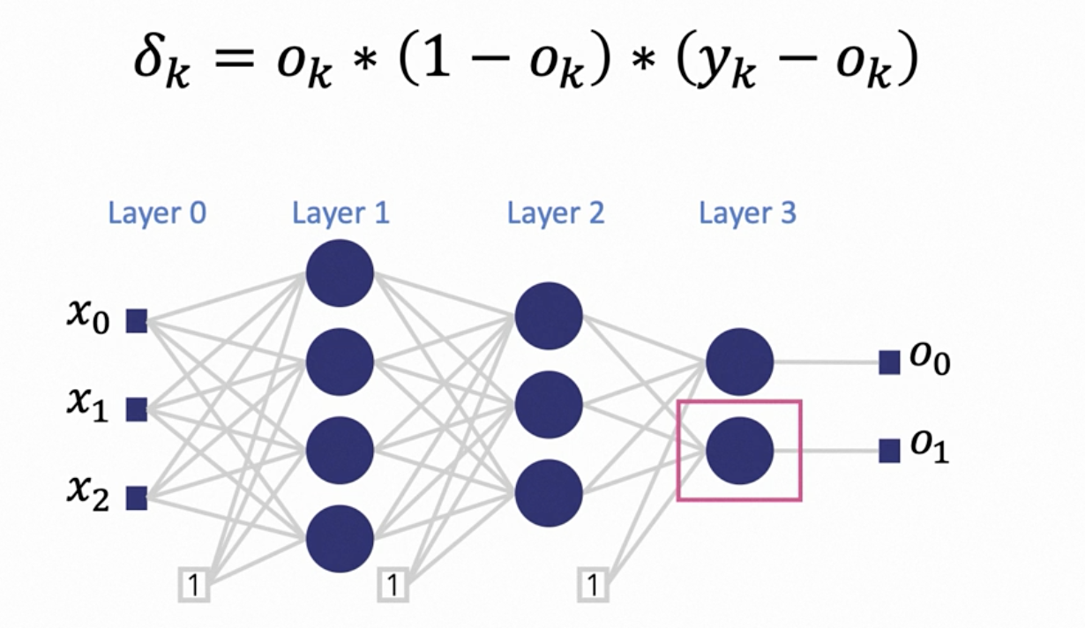
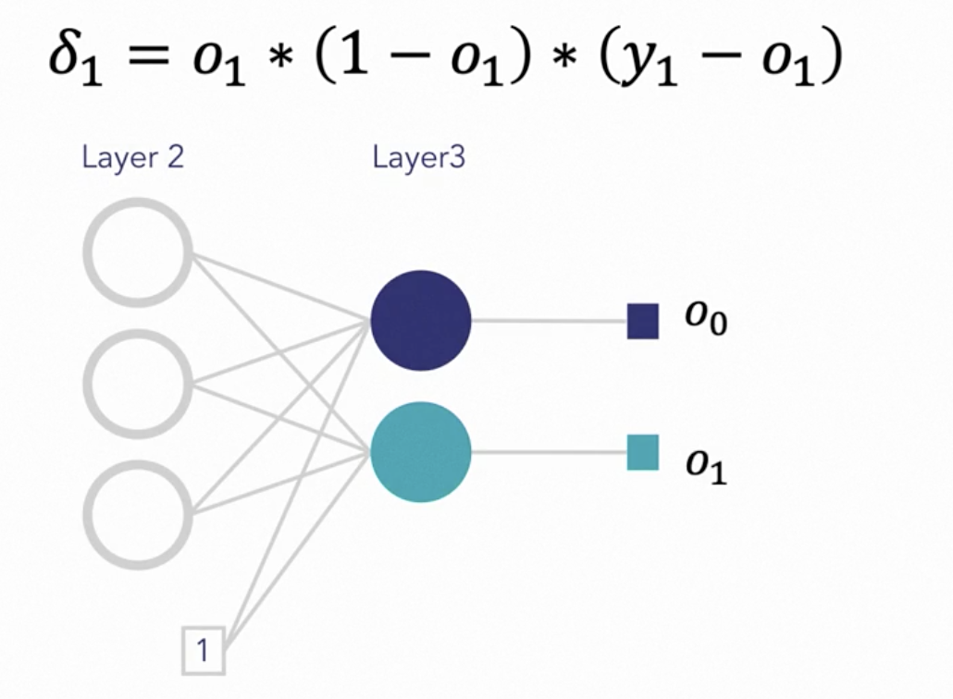
Step 3: Calculate the Output Error Terms
Notes:
(log loss)

Slide 20
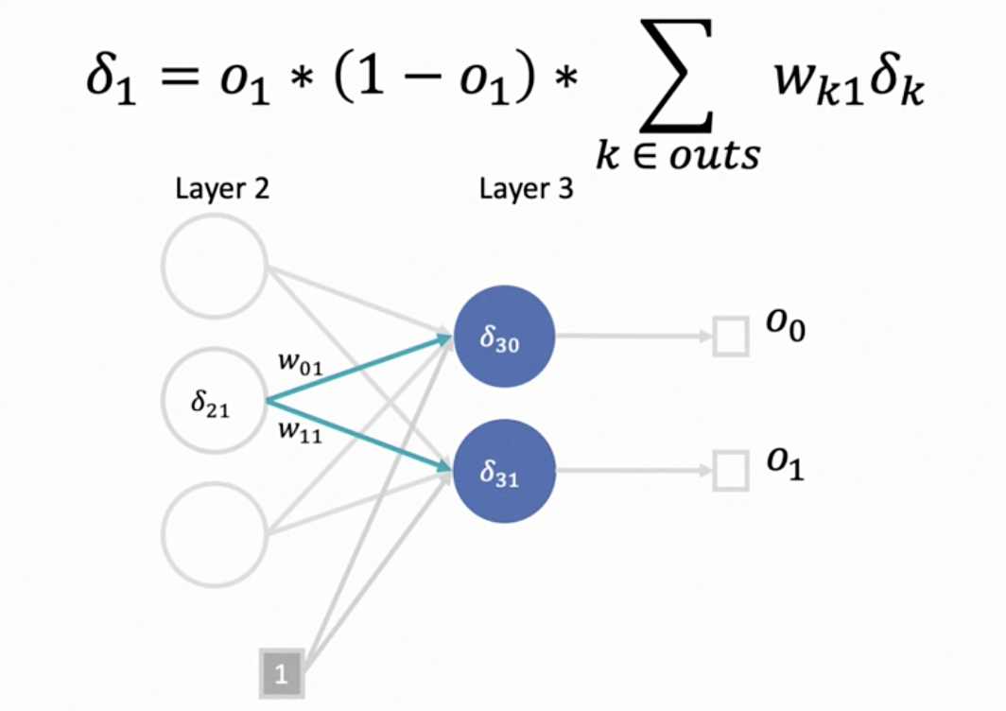
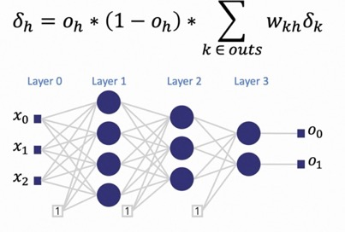
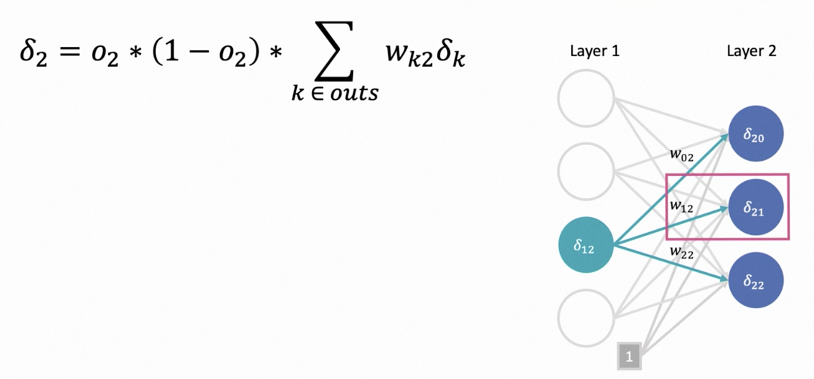
Step 4: Calculate the Hidden Layer Error Terms
Notes:
(log loss)

Slide 21
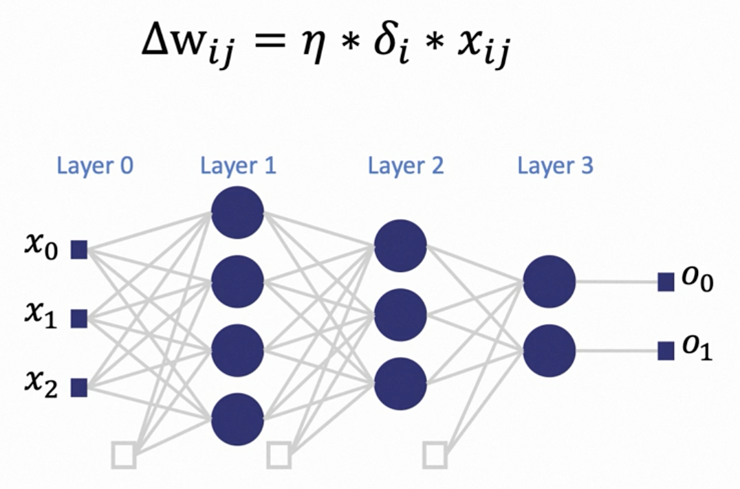
Step 5: Apply the Delta Rule
Notes:
(log loss)

Slide 22
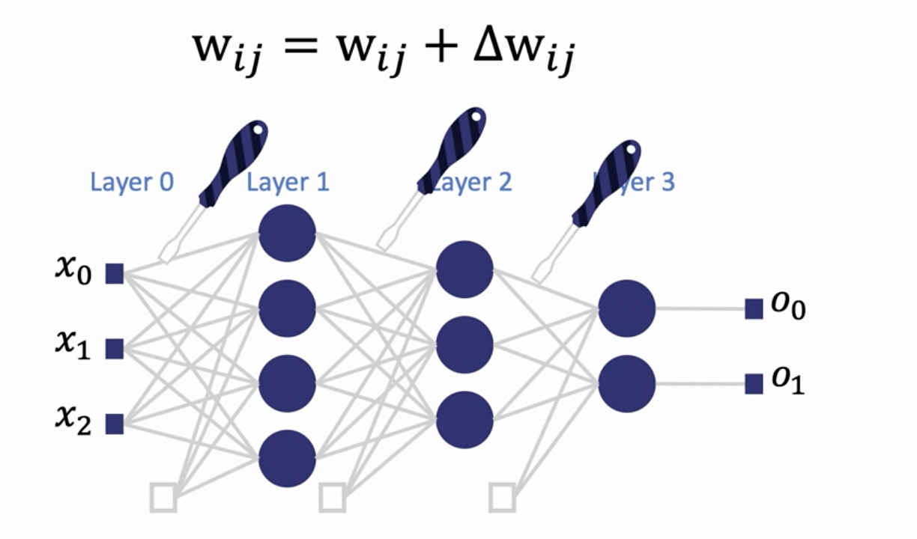
Step 6: Adjust the Weights
Notes:
(log loss)

Slide 23

Optimizers: Types and Their Impact on Training
Optimizers in CNNs are algorithms used to adjust the weights of the network to minimize loss.
Key types include SGD (Stochastic Gradient Descent), which is simple yet effective; Adam, known for its adaptiveness to different problems; and RMSprop, which adjusts the learning rate during training.
The choice of optimizer affects the speed and quality of training, and sometimes a combination of optimizers is used for different stages of training to achieve better results.

Slide 24
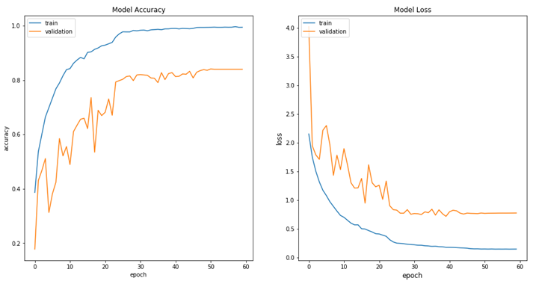
Training a CNN: Steps and Best Practices
Training a CNN involves initializing weights, forward propagation to get predictions, calculating loss, and backpropagation to calculate gradients and optimizers adjust weights.
Best practices include using a validation set for hyperparameter tuning, applying early stopping to prevent overfitting, and periodically saving the model state for recovery. Monitoring training progress with metrics like loss and accuracy, both on training and validation sets, helps in understanding model performance and making necessary adjustments.

Slide 25
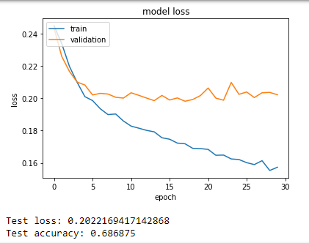
Understanding Overfitting in Deep Learning
Overfitting occurs when a CNN model learns the training data too well, including its noise and outliers, leading to poor performance on new, unseen data.
This usually happens in overly complex models with too many parameters.
Symptoms of overfitting include much higher accuracy on training data compared to validation data.

Slide 26
Strategies to Prevent Overfitting
To prevent overfitting:
Use dropout layers which randomly deactivate certain neurons during training, preventing co-adaptation of features.
Apply regularization methods like L1 (lasso) and L2 (ridge) which penalize large weights.
Augment the dataset to provide more varied training examples.
Simplify the model by reducing the number of layers or neurons.
Early stopping halts training when performance on a validation set starts to degrade.

Slide 27
Hardware Resources for Deep Learning: CPUs vs GPUs vs TPUs
Deep learning, particularly CNNs, requires significant computational resources.
CPUs, with fewer cores, are versatile but slower for this task.
GPUs, with thousands of cores, are ideal for the parallel processing needs of deep learning.
TPUs, designed specifically for neural network operations, provide even faster computations. Choice of hardware can significantly impact training time, cost, and scalability of deep learning models.

Slide 28

Optimizing CNNs for Efficient Resource Use
Efficient resource use in CNNs involves techniques like pruning (removing redundant neurons), quantization (reducing the precision of the numbers used), and using efficient architectures like MobileNets. These optimizations are crucial for deploying models in resource-constrained environments like mobile devices, ensuring a balance between performance and resource use.

Slide 29
Integrating CNNs with Other Deep Learning Techniques
Integrating CNNs with other deep learning techniques like Recurrent Neural Networks (RNNs) for video classification or Natural Language Processing (NLP) models for image captioning enhances their application scope. These integrations allow for multimodal learning, where CNNs process visual data while other models handle different data types like sequential data in videos or text in captions, leading to more comprehensive AI solutions.

Slide 30

Troubleshooting Common Issues in CNN Training
Common issues in CNN training include overfitting, underfitting, and convergence problems.
Strategies to troubleshoot include adjusting learning rates, modifying network architectures, and using techniques like batch normalization and dropout.
Ensuring high-quality and diversified training data is also crucial, as is regular monitoring of performance metrics during training to identify and address issues early.

Slide 31
Techniques to Address Underfitting
Underfitting, where a model fails to capture the underlying trend of the data, can be addressed by increasing the model complexity (adding more layers/neurons), training for longer durations, or using more powerful and diverse feature extraction methods. Another approach is to revisit data preprocessing and augmentation techniques to ensure the model receives sufficient and varied information during training.

Slide 32
CST8508_26W - Midterm Test
Paper based exam on Feb 19 – 7.00pm – 8.00 pm
Total Marks : 25
Duration: 60 min
Calculators allowed
No other personal electronic devices allowed in the classroom during test
Contributes to 15% of final grade
Test Format
Multiple Choice Questions
Fill in the blanks Questions
Short answer Questions
Mathematical Questions

